Slide 1
Introduction
DS-GA 1011: Natural Language Processing
Fall 2020
New York University

Slide 2
Background polls
Seating assignments
Introduce yourself (name, location, background, year in the program). Why are you taking this class?
Who is in NYU Shanghai? What’s your day like?
What are the limitations of current NLP? What would you want NLP to be able to do for you?

Slide 3
Questions about videos?

Slide 4
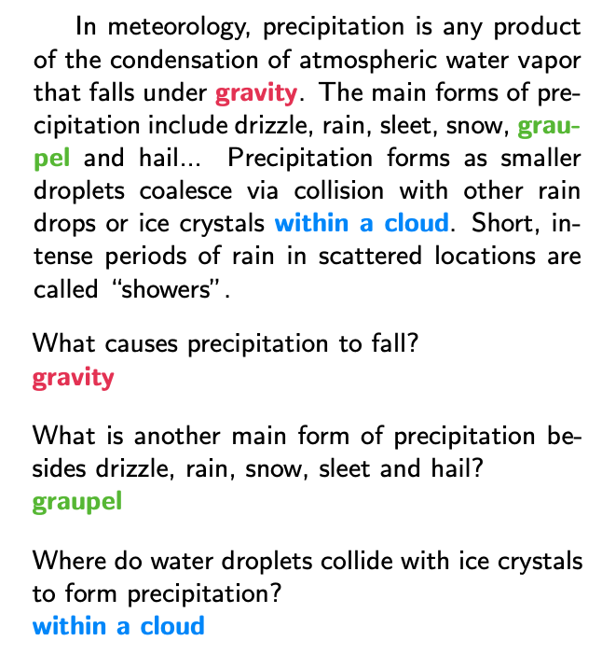
Examples of NLP tasks: Question answering
(Rajpurkar et al 2016)

Slide 5
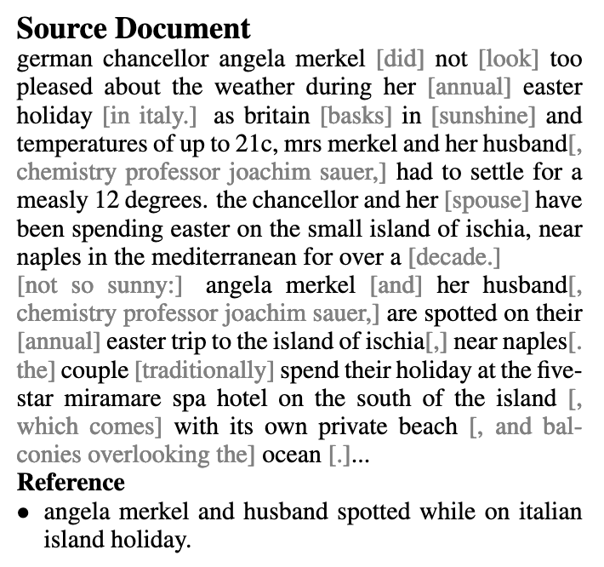
Summarization
(Gehrman et al 2018)

Slide 6
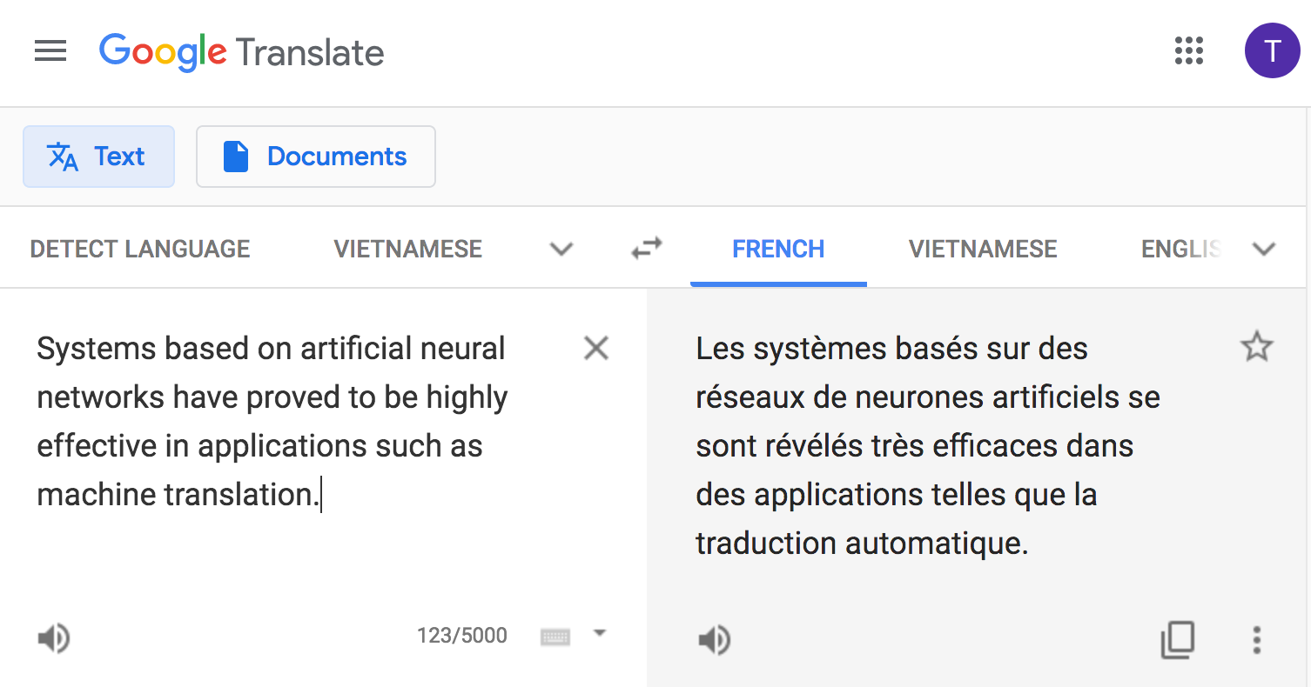
Machine translation

Slide 7

Search (and word sense disambiguation)

Slide 8
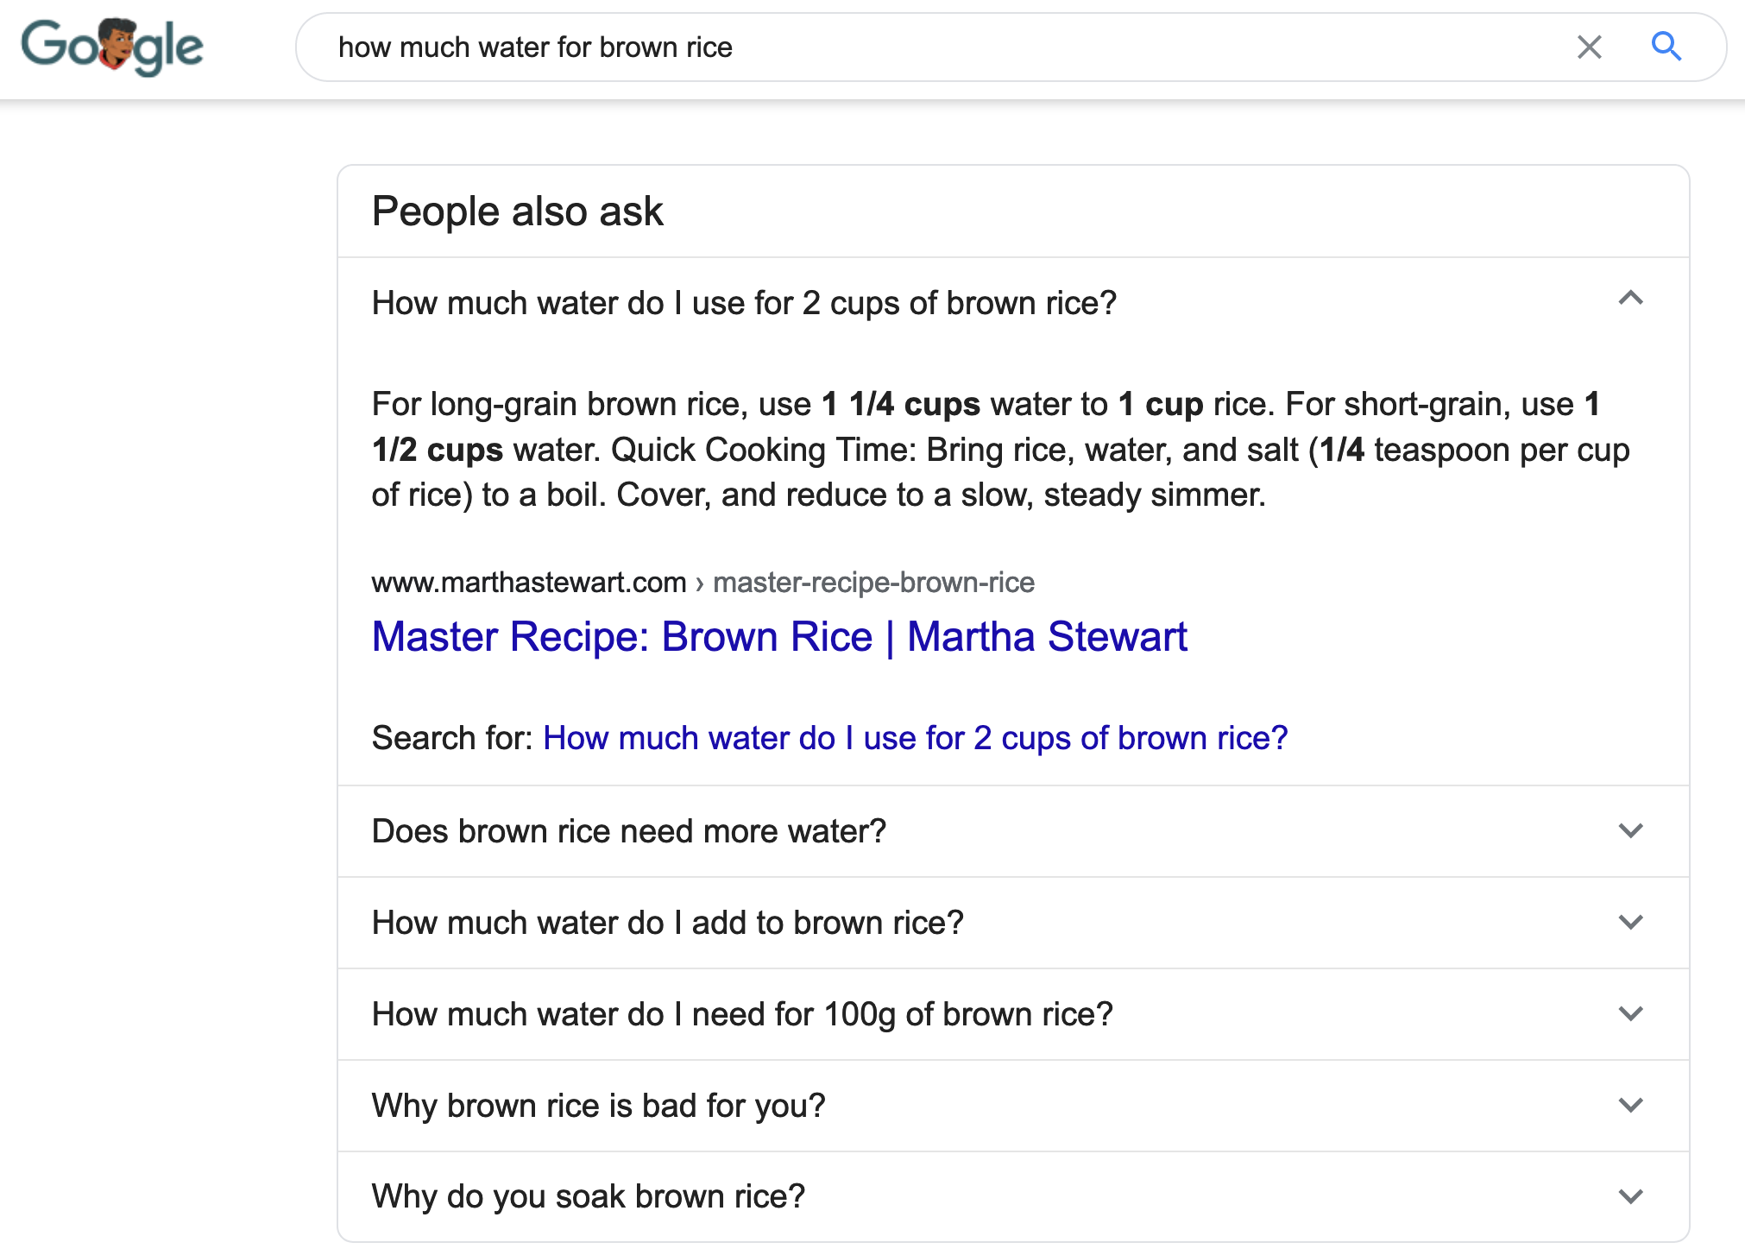
Information extraction

Slide 9

Chatbots

Slide 10
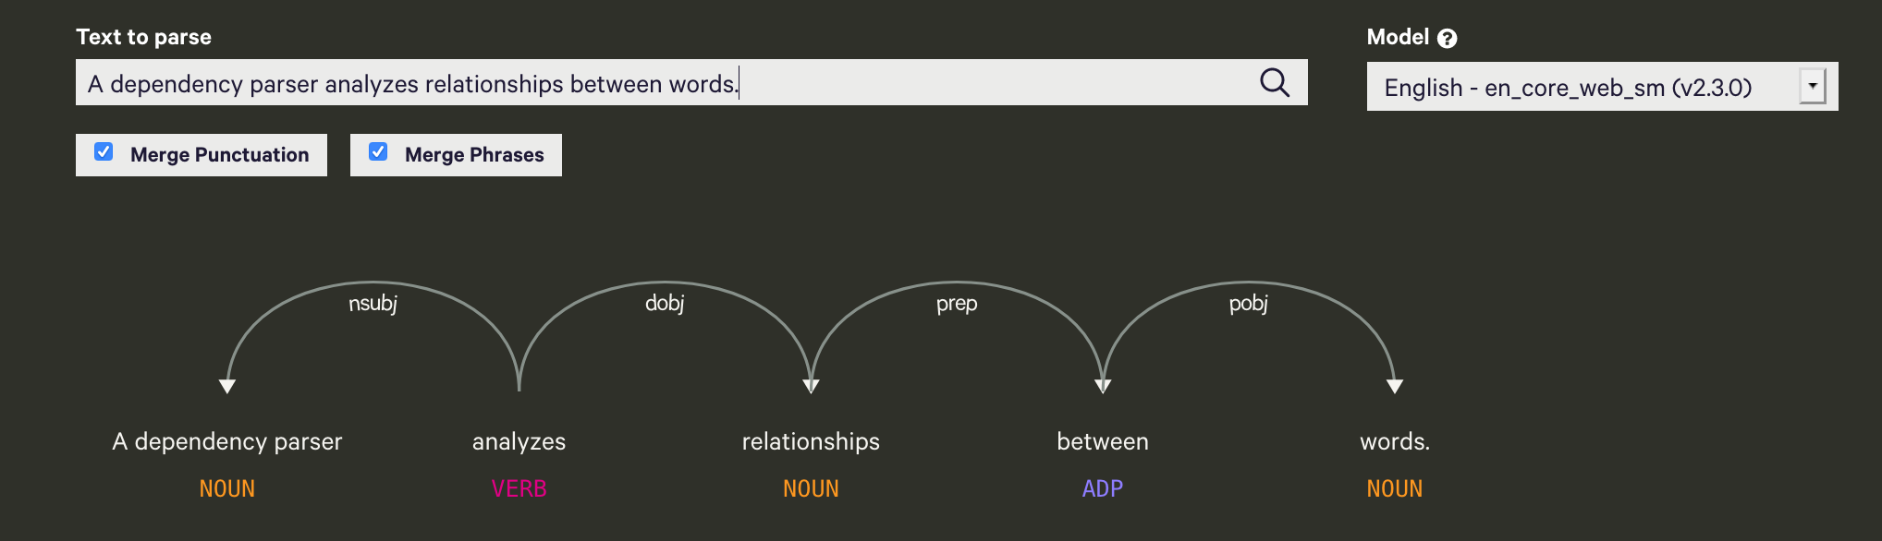
Dependency parsing
(spacy)

Slide 11
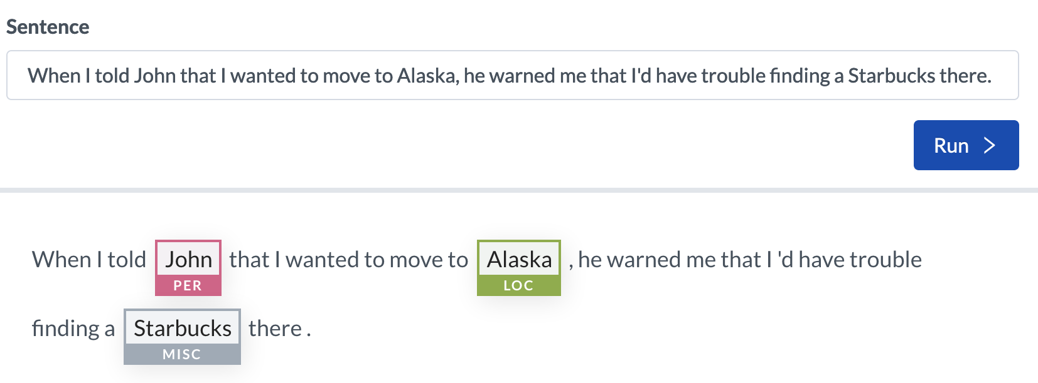
Named entity recognition
(AllenNLP)

Slide 12
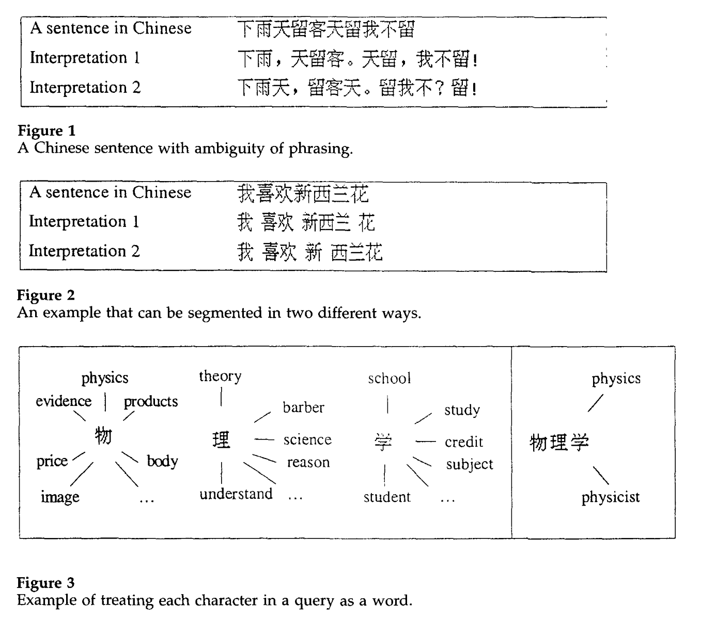
Word segmentation
(AllenNLP)
(Teahan et al., 2000)

Slide 13
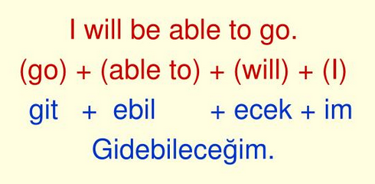
Morphological analysis
(Turkish)

Slide 14
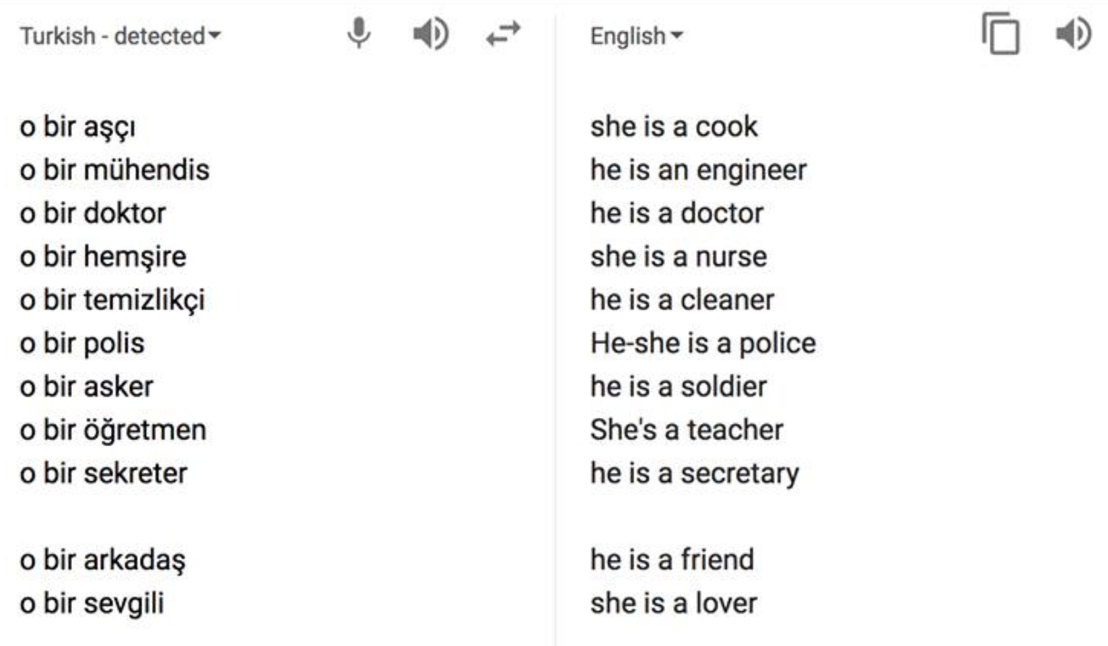
Added in translation

Slide 15
Other cross-linguistic challenges
What are some challenging aspects of a language you speak? How is it different from English?
What would cause potential problems when translating from or to English?

Slide 16
Background polls
How many people have used Python before?
How many people have used Python extensively before?
How about PyTorch?

